Slide 1

A PROJECT ON
Auto fault detection and protection via tripping of distribution lines as well as alert over the internet.
[B.Tech 8th sem]
As a part of curriculum of
Birsa Institute of Technology, Sindri (BIT.Sindri)
Under the guidance of:
Dr K Sarwagya .
Assistant Professor
Department of Electrical Engineering
Submitted By:
Rahul kumar saw 18030450061
Vishal Kumbhakar 18030450100
Raju kumar Yadav 18030450062
Prabhat Agarwal 18030455007

Slide 2
CONTENTS
Objective
Abstract
Circuit Diagram
Methodology
Simulation and Hardware
Observation table
End Result
Future scope
Conclusion

Slide 3
Objective of the Project
The main objectives of this project work are:
To automatically detect fault in different phases and find the exact location of fault as well as phase
To detect Fire due to fault at all data collection point in 3-phase distribution line and alert using buzzer.
To trip the line in any fault and display the information in LCD as well as to the authority over the internet

Slide 4
ABSTRACT
In Electrical Power System, there are High Voltage Transmission Lines between generating station and substation as well as Low Voltage Distribution Lines between substation and load. There are a variety of faults like Line to Ground faults(LG), Line to Line faults(LL), Line to Line to Ground fault, etc. that can occur in these lines which causes a huge amount of current flow through these lines then it may cause heavy damage to the equipment that are connected throughout the Power System. Moreover, it may lead to public hazards.
Already there are protection systems which trip the lines during faulty situation, but this Project is designed in such a way that not only it automatically trips the Lines during fault but also alerts us about the fault in any place around the world as this communication will be over internet connection.
We can get the location, current parameters and status of the faulty condition and remotely control various apparatus through internet. Also, the system automatically resets itself in case of temporary fault.
Since it would be highly risky and dangerous to work directly on high voltage lines, the system model would use 220V AC domestic line. The system will consist of three single phase transformers which converts 220V into 12V which would be safe for small scale model. The output of three transformers would be configured as star connected 3-phase Line.
Switches would be used to create manual faults and Arduino along with IoT would used for control and communication purpose. There would be relays acting as circuit breakers for tripping the line. Arduino would turn ON the supply after a short time interval in case of temporary fault and trips permanently otherwise. There would be LCD display which would show current parameters and a Wi-Fi module for common.

Slide 5
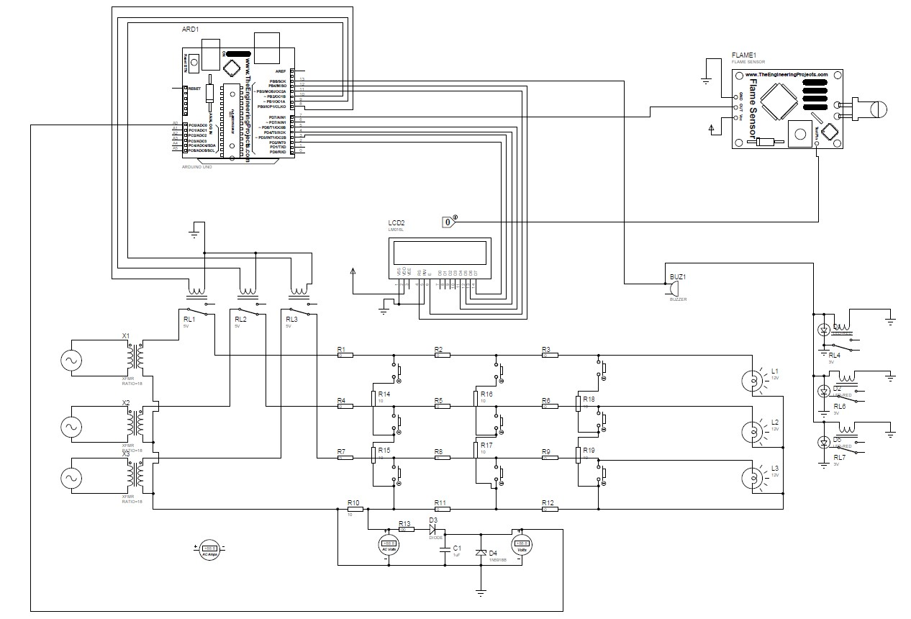
CIRCUIT DIAGRAM

Slide 6
METHODOLOGY WORKING
Three parallel division RYB of single 220V AC Source and Transformer converts these into 12V.
Star Connection in secondary of Transformer with each live wire through NC of relay.
Lumped resistance of 10 ohm in each line divided into 3 sections each.
Lamps are connected as load.
Switches for manual fault.
Rectifier to convert AC to DC for Arduino Analog input.
Zener diode to limit maximum voltage of 5V as required by Arduino.
16*2 LCD Display and previous relays connected to digital Output pins of Arduino.
LCD to see current status of Lines and Relays to trip in case of fault.
Flame Sensor is connected to digital input of Arduino.
Another 3 relays and a buzzer are connected to digital output pins of Arduino.
In case of fire trips all three lines.

Slide 7
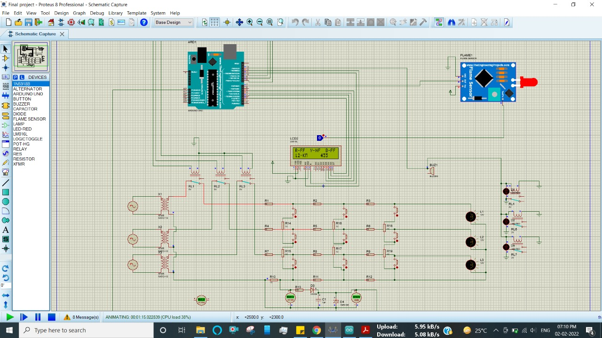
Compiler & Stimulation Software-PROTEU SIMULATOR- Proteus is software for microprocessor simulation, schematic capture, etc. It is developed by Labcentre Electronics for an electronic design automation. This enables its use in a broad spectrum of project prototyping in areas such as motor control, temperature control and user interface design.
SIMULATION AND HARDWARE
PROTEUS SOFTWARE

Slide 8
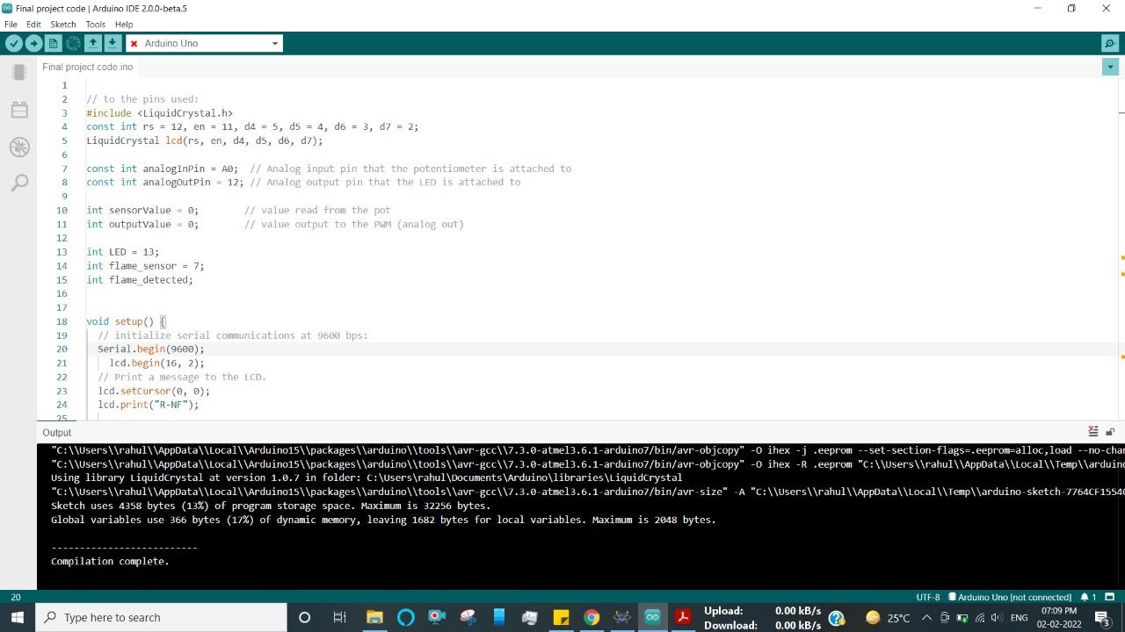
ARDUINO IDE

Slide 9
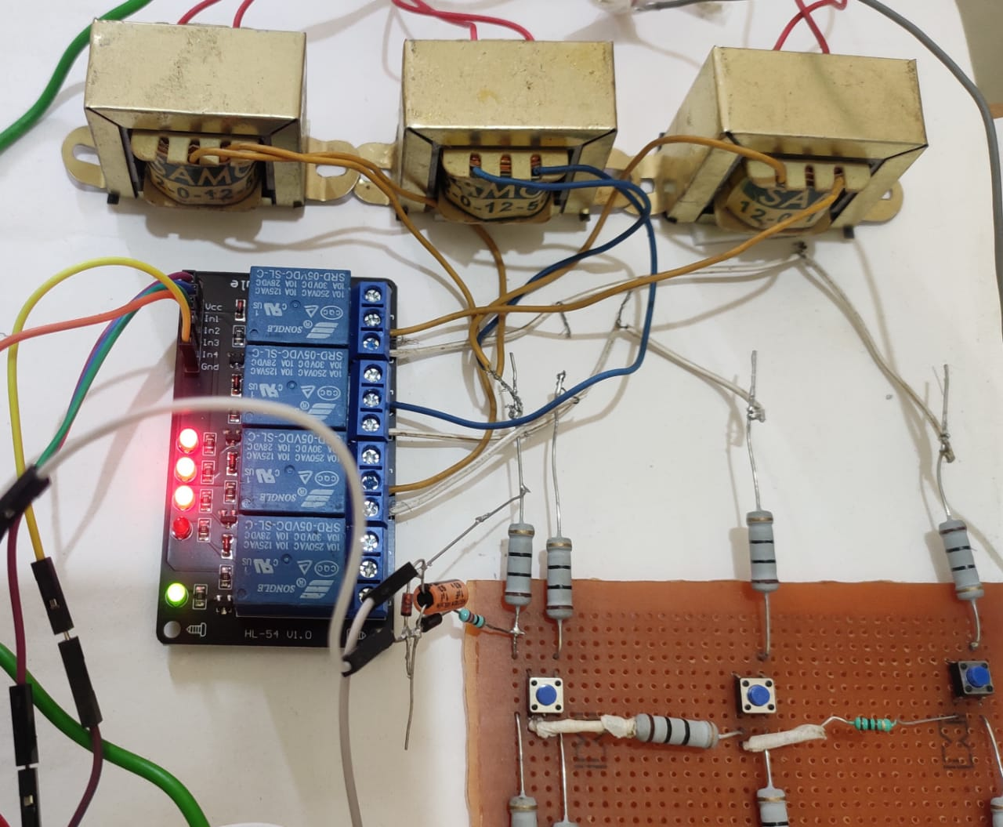
HARDWARE UNIT
POWER SUPPLY UNIT:
1. Single Phase is distributed parallelly in 3-phases to create 3-phase distribution line.
2. 3-Step Down Transformer converts 230v AC to 12v AC which is safer to work on.
3. Secondary side of Transformers are connected as Star Connection which are connected to fault creating circuit through relay in each phases.
4. External 5v DC supply is provided to Arduino and relay operating units.

Slide 10
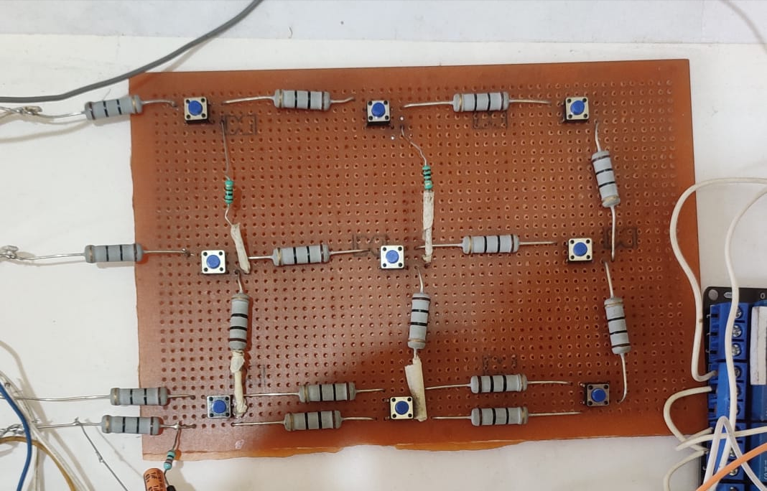
Fault Creating Unit
1. 4 rows of resistors are created to demonstrate the distributed resistances of specific distance offered by 3 phases R, Y, B and neutral.
2. Push buttons are used to manually create the fault in the lines
3. Also, resistances are inserted between adjacent lines to distinguish fault in different phases.
4. Each resistance in rows is 10ohm and resistance between adjacent rows are 10 and 100ohms.
5. Rectifier circuit is used to convert AC voltage across a resistance in neutral line into DC so that Arduino can read from it. It demonstrates the distance relay in practical world.

Slide 11
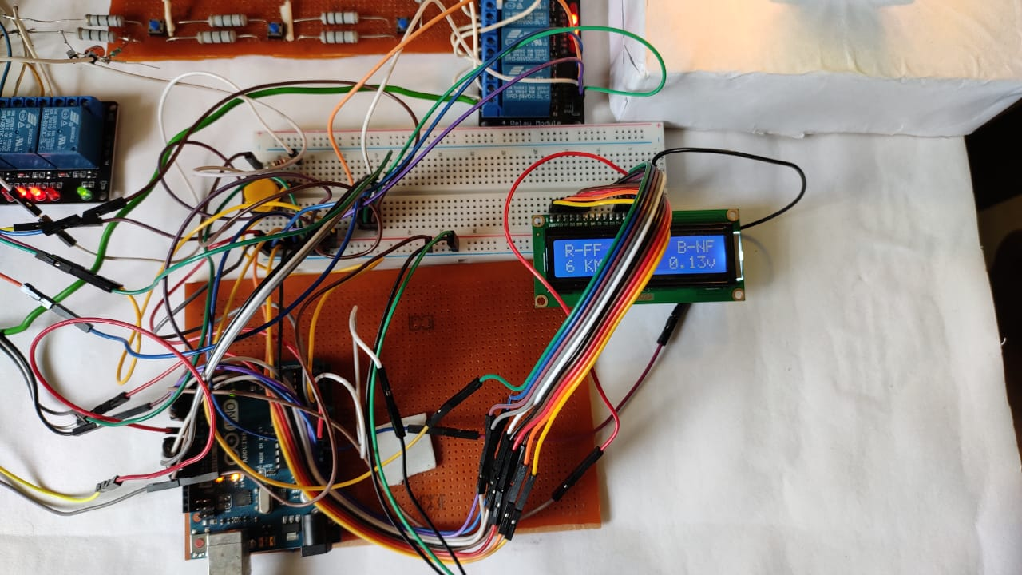
Arduino Operating Unit
Arduino is the main component of our project. It’s function include the following
1. Read DC voltage from fault creating circuit which is different when different push buttons are pressed and display the fault in display and fault distance in KM.
2. It sends signal to relay operating unit to trip the line in case of fault.
3. It receives signal from flame sensor unit and alert using buzzer.
4. It communicates with wireless transmission unit to transfer the fault status data via internet.

Slide 12
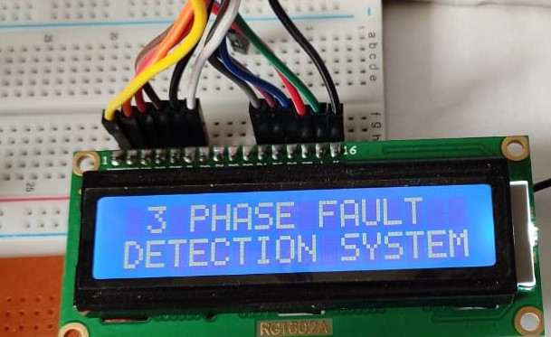
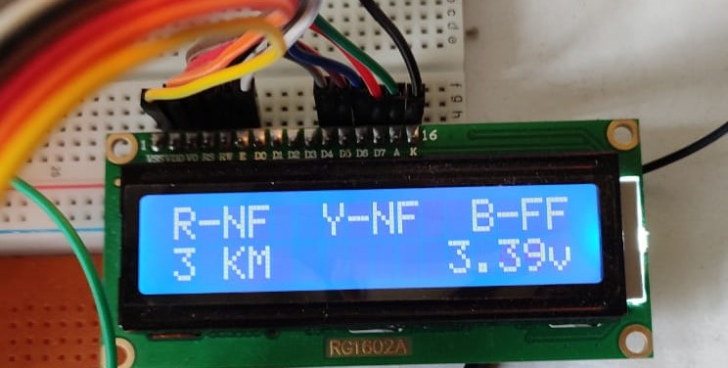
Display Unit
1. When the fault occurred in any of the phases then the following information are displayed on the 16 X 2 LCD display.
a. Fault status (in which phase fault has occurred).
b. Distance from the source to the fault.
c. DC voltage from creating unit (through rectifier).
2. NF- shows no fault, FF- shows Fault in the phase.
3. In case of fire detection, it displays “Fire Fire Fire”.

Slide 13
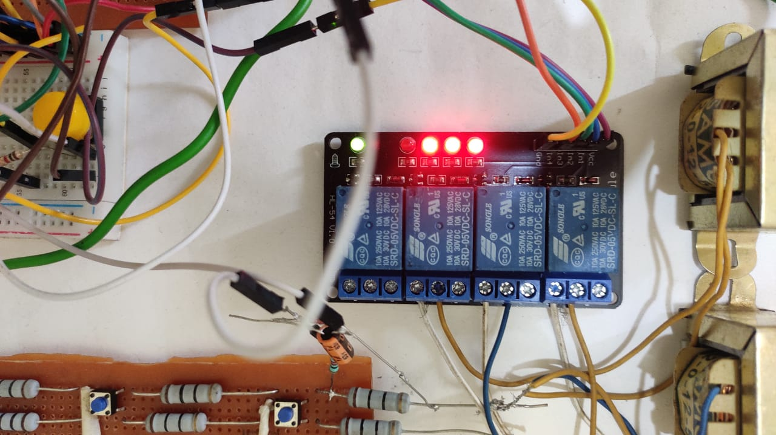
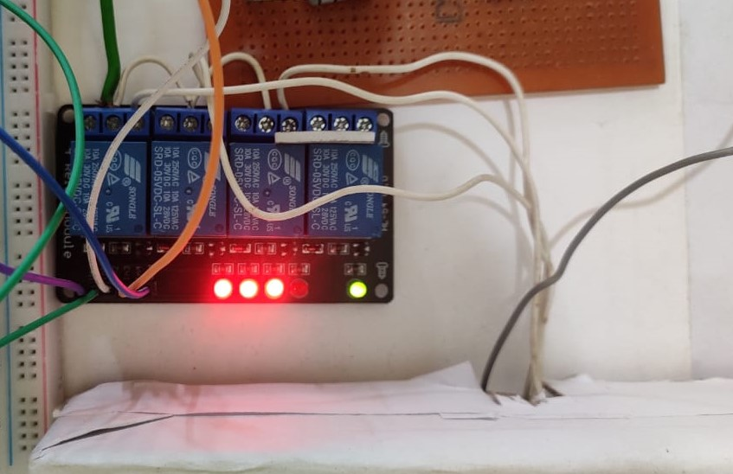
Relay operating Unit
1. Three relays are connected through the three phases R, Y, B to trip the line in case of fault or fire.
2. Each phase is connected to the NC of relays and tripping signal pins are connected to the Arduino.
3. Another three relays are connected to the three bulbs representing the loads of three phases.

Slide 14
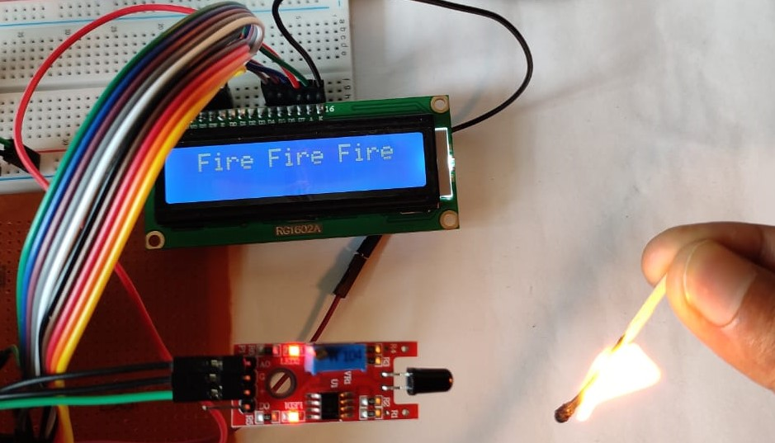
Flame Sensor Unit
When the fault occurred in the system high value of current will flow as a result temperature of the lines increases and fire occurred and this will be sensed by the flame sensor. we would be alerted by the buzzer and simultaneously relay would be tripped.

Slide 15
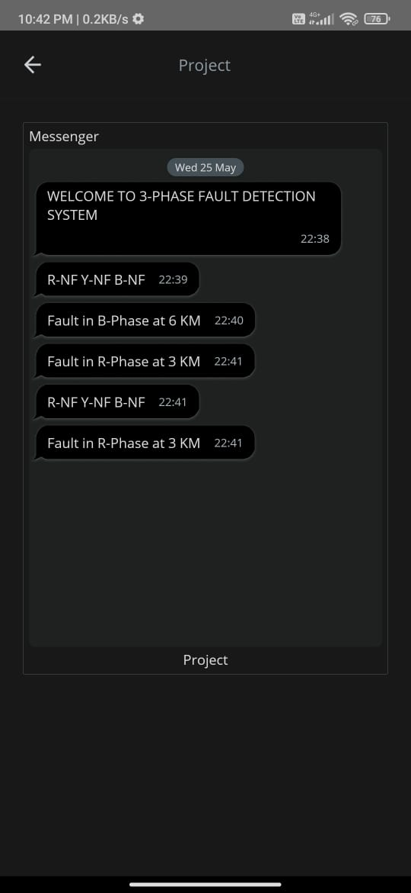
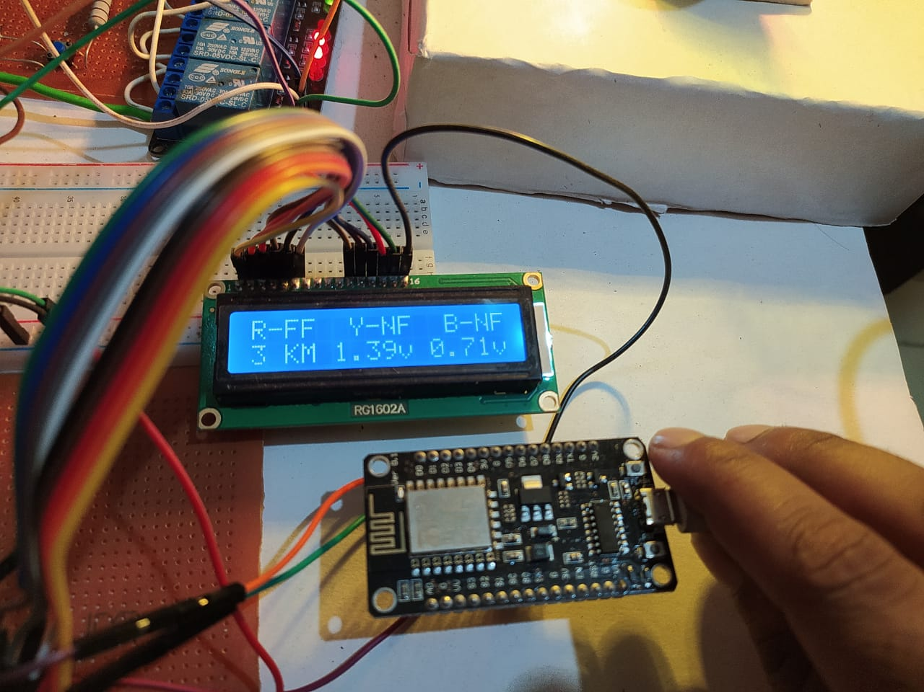
Wireless Transmission unit
1. NodeMCU board which contains ESP8266 WIFI Module is used for wireless data transmission.
2. Serial Communication is set up between Arduino operating unit and NodeMCU and then data is transmitted to the cloud from NodeMCU through internet.

Slide 16
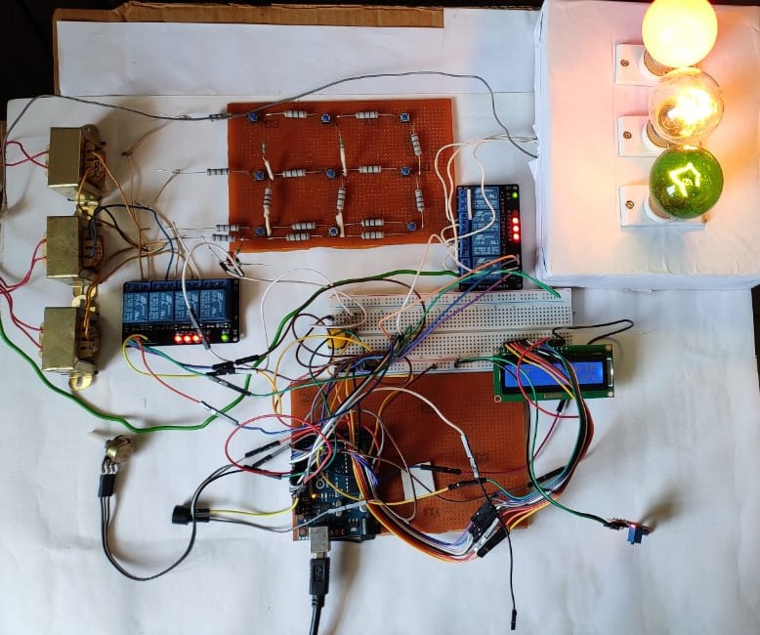
Assembled Model

Slide 17
OBSERVATION TABLE
SI.No | Line Fault Status |  |  | Fault Distance
 | Status of R Phase | Status of Y phase | Status of B phase
1 | NF | NF | NF
2 | FF | NF | NF | 3KM
 |  |  |  | 6KM
 |  |  |  | 9KM
3 | NF | FF | NF | 3KM
 |  |  |  | 6KM
 |  |  |  | 9KM
4 | NF | NF | FF | 3KM
 |  |  |  | 6KM
 |  |  |  | 9KM
Observation Table Line Fault status

Slide 18
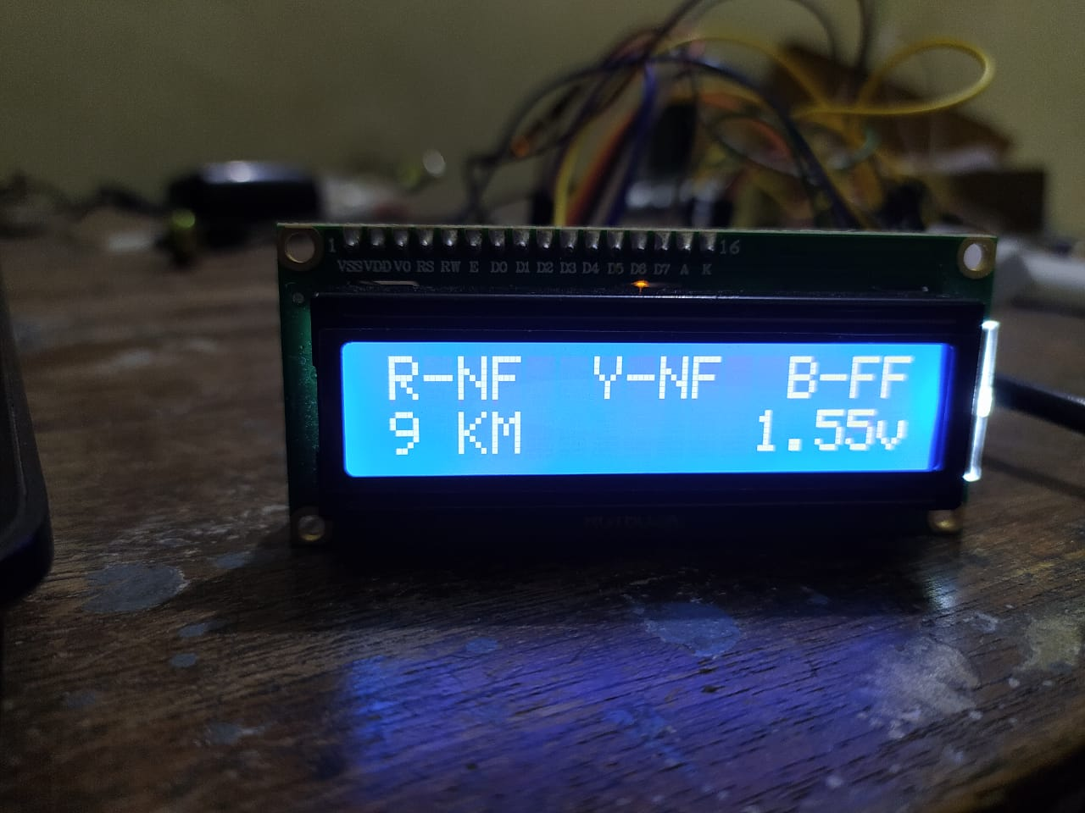
END RESULTS
End result for 3-Phase fault detection circuit can be drawn as:
So designed circuit for the detection of fault in distribution line are successfully able to detect the short circuit fault between the range of km in transmission line.
Designed circuit is successfully able to detect the phase in which fault is occur
Circuit is successfully able to provide information about the distance of fault from the source in the cable.
In Case of any fire due to fault the flame sensor detects it and alerts us through Buzzer and Display the information in LCD.

Slide 19
FUTURE SCOPE
This system provides precise information on the type of fault that occurred in the line, such as L-G, L-L, and so on.
Because of the WIFI Module (ESP8266), which provides real-time status of the transmission system, we can easily track it from anywhere in the world. There is less upkeep.
This system is more adaptable than the current system, allowing it to quickly resolve the time taken to locate a fault in any area.
Because of its small size and light-weight, we can easily install the device on a pole.
Reduce human intervention.
More accuracy.
Improved Safety & security.

Slide 20
CONCLUSION
We have been able to successfully detect the fault by using Arduino and DC relays by taking both the input voltage as AC and DC sinusoidal. it is observed that when the current value
obtained from the secondary current value of the current transformer is greater than the preset value of the relay then fault is detected by the Arduino. The result is displayed on the LCD
screen. We can set different trip time delay using definite time characteristics of the relay. By this project it can be ensured faster detection of faults than the electromechanical relay on the power lines and their advanced analysis can be studied from the recorded data by the arduino programming , as well as data will be displayed in mobile app using ESP8266 , Also the method we followed to find out the RMS value of the voltage
gave error of about 2-8% error of the acutal calculated RMS value

Slide 21
REFRENCES
[1] https://www.arduino.cc/
[2] https://quartzcomponents.com/
[3] https://circuitglobe.com/
[4] http://www.oaijse.com/
[5] http://fazpublishing.com/jepes/index.php/jepes/article/view/16/14
[6]https://www.researchgate.net/deref/http%3A%2F%2Fwww.ijsrd.com%2Farticles%2FIJSRDV3I1094.pdf
[7] https://springerplus.springeropen.com/articles/10.1186/s40064-015-1080-x
[8] https://create.arduino.cc/cloud/things/169296e8-4259-4b5d-8d51-f559f08a48eb
[9] https://sqingredients.com/v0s9qhp/3-phase-detection-using-arduino.html
[10] https://www.arduino.coach/iot-under-ground-cable-fault-detection-using-arduino-3.html
[11]https://www.researchgate.net/publication/321097011_AUTOMATIC_FAULT_DETECTION_AND_PROTECTION_OF_THREE_PHASE_INDUCTION_MOTOR

